Slide 1
Module 7.1 – Control Systems
Introduction to Control Systems

Slide 2
Control Systems
Control System is a device or mechanism that regulates a process or entity
Commonly used in automation, transportation, manufacturing and robotics
Control systems are studied in engineering, mathematics and computer science
Notes:
Control Systems are an essential component to many industrial applications
Control Systems are used to safely refine oil, cook packaged foods, and fly airplanes.
The theories and concepts required to build successful control systems are studied by a diverse set of disciplines.

Slide 3
Open-Loop
Open-Loop control systems do not incorporate feedback from the controlled system
A light-switch is an example of an open-loop control system
Reference
Controller
System
Notes:
Controllers in open-loop control systems cannot access the state of the system that they are controlling.
Oftentimes, open-loop control systems are infeasible because the controller could cause the system to reach an unsafe state since it does not know when to apply different inputs.

Slide 4
Closed-Loop
Closed-Loop control systems incorporate information from the system (examined through sensors)
An oven is an example of a closed-loop control system
Reference
Controller
System
Sensor
Notes:
Generally research focuses on Closed-Loop control systems because these systems are more complex than open-loops, and they have the ability to adapt to changing systems
Any controller that is able to infer information about the state of the system that it is controlling can incorporate this data into its decisions to become a closed-loop control system.

Slide 5
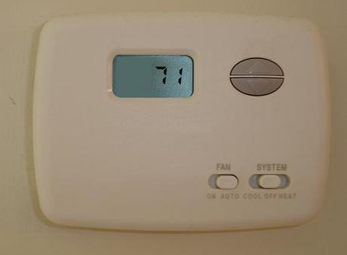
Example: Thermostat
The thermostat in buildings is a closed-loop control systems
The thermometer is the sensor that provides feedback.
The reference temperature is the settings configured by the user.
The system attempts to match the temperature of the building to the desired reference temperature by turning on/off the heater/air conditioner.
Notes:
Thermostats generally have two reference temperatures (the temperature that triggers heating and the temperature that triggers cooling).
Thermostats are only effective when their internal thermometers accurately measure the internal temperature of the house
What is a thermostat’s thermometer were placed in the kitchen near the oven, how would this affect the control system?
Intelligent thermostats like Nest use advanced machine learning and artificial intelligence approaches to anticipate changes.

Slide 6
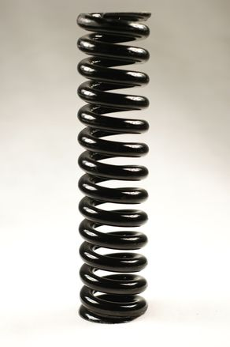
Frequency Response
Some control systems oscillate in response to inputs
A spring-mass system exhibits oscillations when the mass is pulled.
Frequency response is the way an input frequency is converted into an output frequency.
Notes:
A concrete example of a frequency response is the thermostat.
When the measured temperature dips below the reference temperature, the heater is applied.
When the measured temperature exceeds the reference temperature, the heater is stopped.
Then the measured temperature will slowly decrease as the temperature of the home approaches the colder outside temperature.
This will eventually cause the heater to be applied again, the temperature is thus oscillating as the heater is turned on and off.

Slide 7
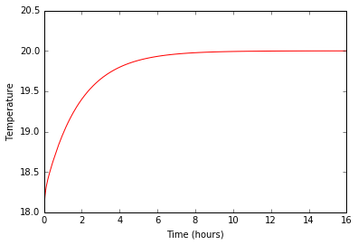
Overdamped
No oscillations
Slowly converges to reference
Notes:
Overdamped systems will eventually reach the desired result (in this case 20 degrees) but it may take a long time to converge

Slide 8
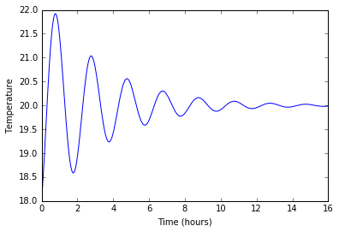
Underdamped
Oscillations
Slowly converges to reference
Notes:
Underdampd systems will always converge but it will oscillate as it approaches the reference.

Slide 9
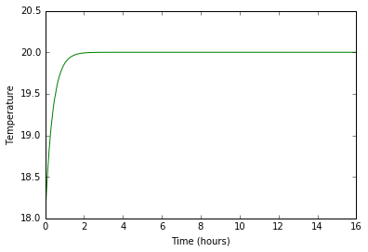
Critically Damped
No oscillations
Quickly converges to reference
Notes:
Critically damped systems converge as quickly as possible without oscillating to the reference.
Oftentimes, engineers desire perfectly damped solutions that do not oscillate but converge quickly.

Slide 10
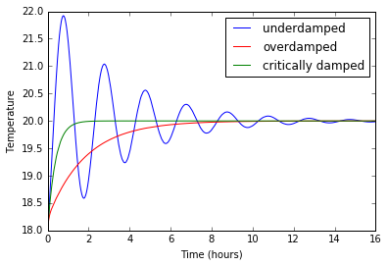
Damping Comparison

Slide 11
Fourier and Laplace Transform
Two mathematical techniques for analyzing frequency responses are the Fourier and Laplace transforms
These are often used in control systems to characterize how the system will respond to various control inputs.
Fourier and Laplace transforms convert functions of time into functions of frequency
Notes:
Many modern control systems are evaluated and solved using frequency domain analysis because it is often a simpler representation of the problem.

Slide 12
The GPU Teaching Kit is licensed by NVIDIA and California Polytechnic State University under the Creative Commons Attribution-NonCommercial 4.0 International License.

